Slide 1







SMART CUSTOMER SERVICE PLATFORM

Slide 2

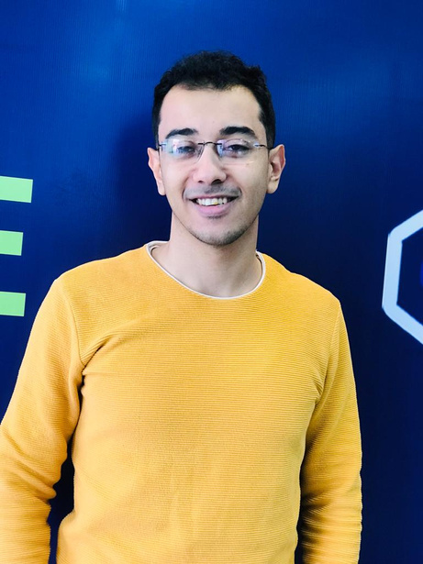
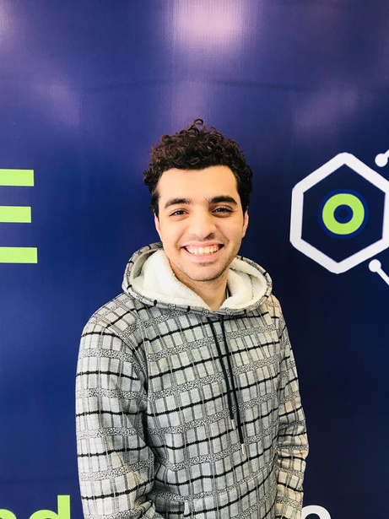
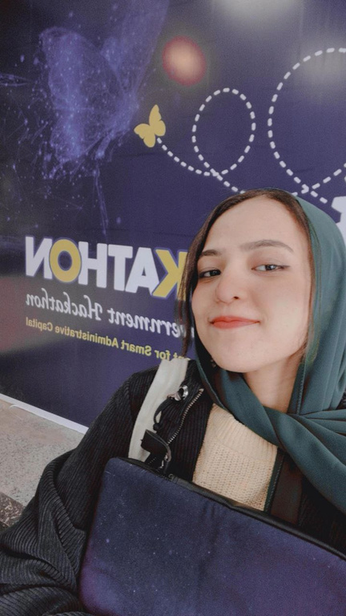

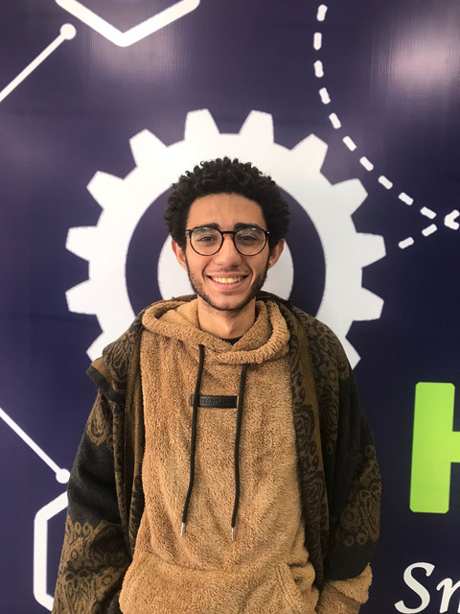
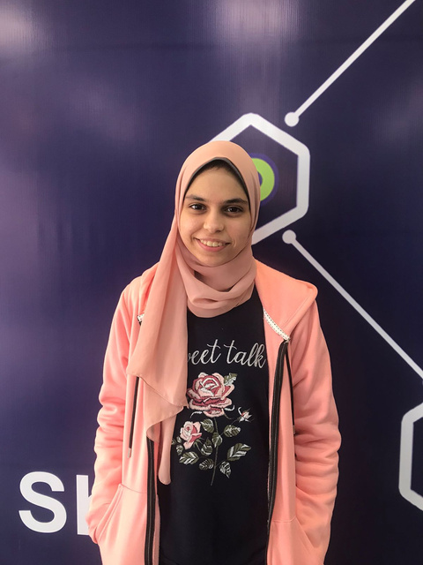

OUR TEAM
Abdelrahman Elsayed
Ammar Ahmed
AI Engineer
Data scientist
Supervised by Assoc. Prof. Lamiaa Elrefaei
Sabah Mohammed
Fultter Developer
Fady Zarif
Nada Mahmoud
Full stack Developer
ML Engineer

Slide 3

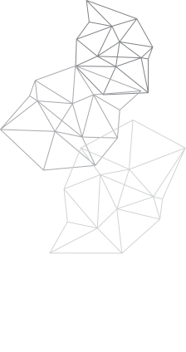

AGENDA
Introduction
DATA GATHERING
SYSTEM DESIGN & IMPLEMENTATION
SYSTEM TESTING
FUTURE WORK

Slide 4


INTRODUCTION
PROBLEM DEFINITION , SUGGESTED SOLUTION , PROJECT SCOPE

Slide 5


PROBLEM
DAILY USERS PREFER THE PHYSICAL PLACE OF SERVICE PROVIDERS TO ASSIST THEM IN THEIR NEEDS
HUMANS ARE ADDICTED TO DEALING WITH HUMANS
THAT'S WHY PEOPLE ARE ADDICTED TO SOCIAL MEDIA, WHY CHATGPT IS REPLACING GOOGLE

Slide 6

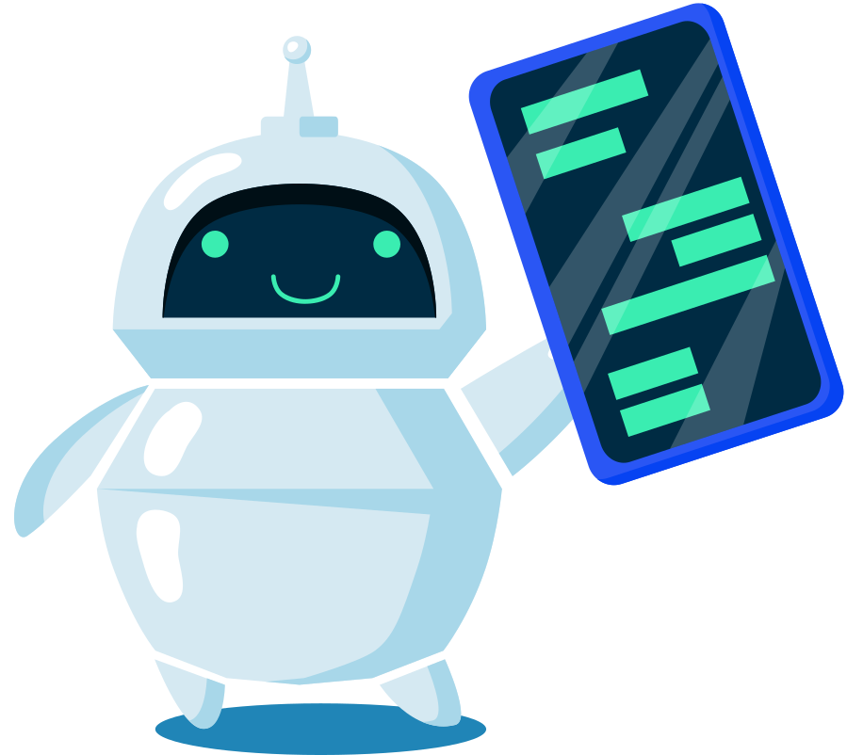

SOLUTION
After intensified group brainstorming, use of techniques like SCAMPER, understanding, analyzing the problem we decided that:
Our project will focus on developing a conversational AI platform with the goal of providing a smart system that can serve multiple service providers to automate their services in hopes of saving valuable time, money, and manpower, and providing users with 24-hour assistance.

Slide 7













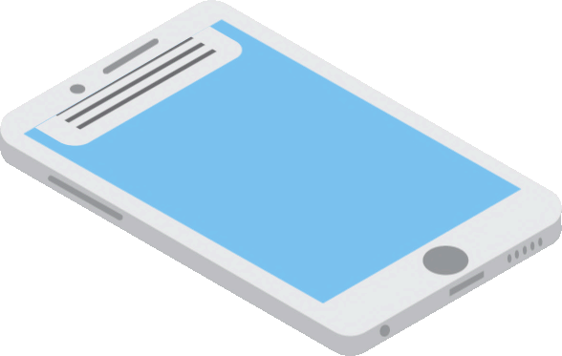
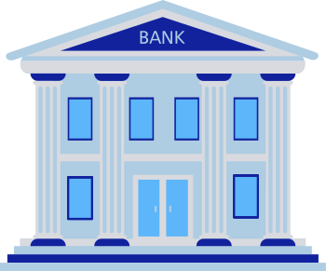

scope
EDUCATION
HOSPITALS
E-COMMERCE
GOVERNMENT
BANKS

Slide 8
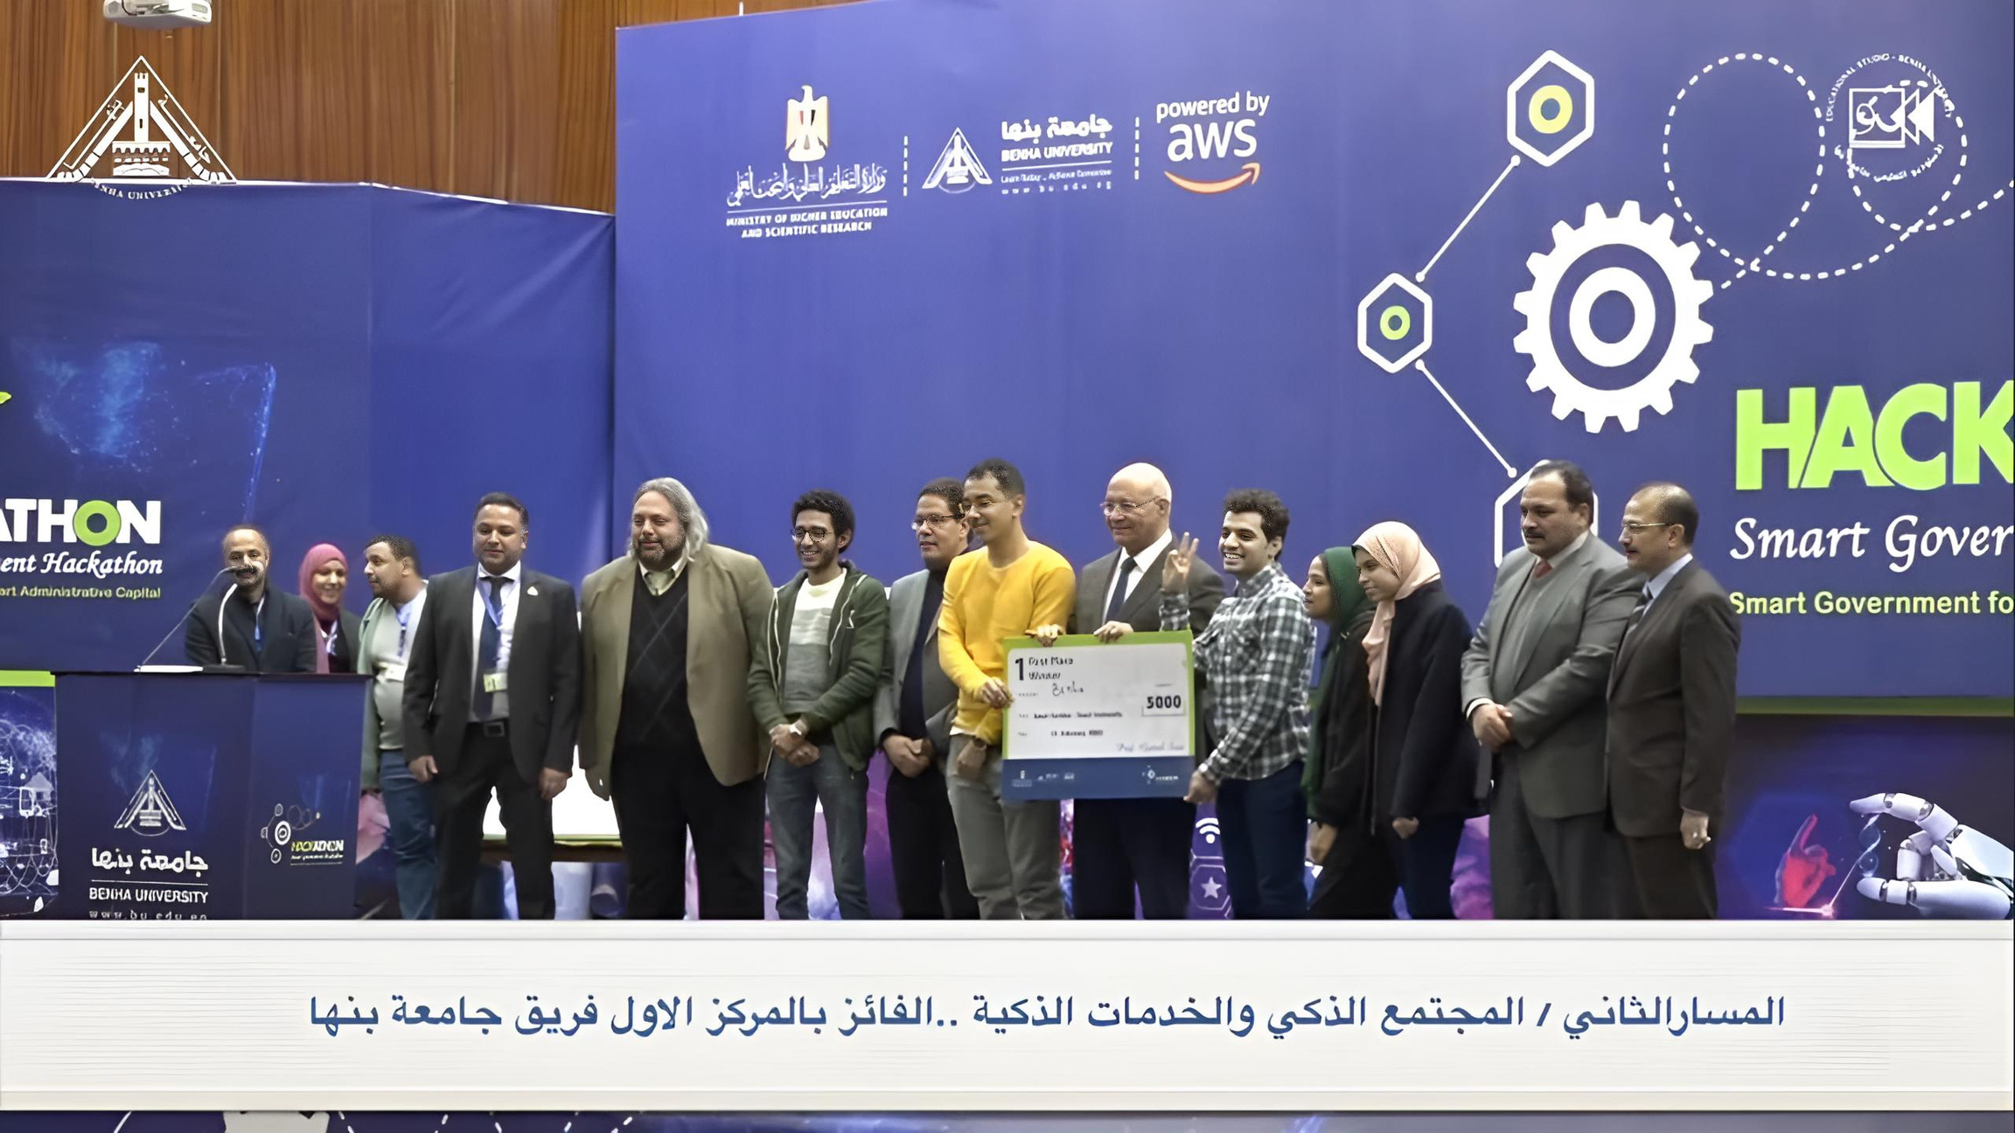

Slide 9
DATA GATHERING
LITERATURE REVIEW, QUESTIONNAIRE, INTERVIEW

Slide 10


Literature Review
Reference | Domain | Implementation | Interface | Main Results
Trappeyet al | Healthcare | pre-trained BERT Model | created by unity and connected to a server | The emotional understanding of words as part of the empathic responses of the chatbot’s dialog did impact the participants stress levels. It decreased in the experiment, reflecting that the empathic conversations effectively created a supportive environment
Al-Ajmi, et al | Flight booking | Wit.ai framework | Telegram bot | The evaluation results showed that the developed system was effective in booking and was easy to use. it also became smarter after being fed with participant booking examples.
Alshareef et al | Open domain | seq2seq Neural Network pre-trained word embedding | Integrable Chatbot | The average BLEU score of the pretrained word embedding model with Fast-Text achieved high average BLEU score than the not pretrained model
Alhassan et al | Troubleshooting IT problems leshooting | AI keyword matching | N/A | Chatbot could handle any type of Arabic data without having strict inputs to a specific form.

Slide 11


QUESTIONNAIRE
our goal was to see the daily users’ point of view of the mobile application and chatbot technology.
Rate your previous customer service experience
Do you think the use of chatbots will save customers time?
please rate your experience with chatbots.
NO
13.3%
1
4.1%
8-10
19.6%
5
25.5%
1-4
35.3%
MAYBE
15.3%
3
25.5%
YES
71.4%
5-7
45.1%
4
40.8%

Slide 12


INTERVIEW
we conducted an interview targeting the healthcare domain, with Dr. Abanoub Yousry Samuel.
KEY takeaway
Current health care management system:
Combination of paper-based and electronic systems
Time-consuming and demanding for patients and healthcare providers
leads to errors and delays in processing patient information
Features:
Appointment scheduling and management
Patient information and medical records management
Prescription management
Billing and payment processing
user-friendly and easy to navigate

Slide 13
SYSTEM DESIGN
AND
IMPLEMENTATION

Slide 14


TOOLS
Most important tools we used:
Flutter
An open-source mobile app development framework for Android and iOS platforms using a single codebase.
Rasa
It is an open-source framework for building chatbots
Firebase
provides a suite of backend services

Slide 15



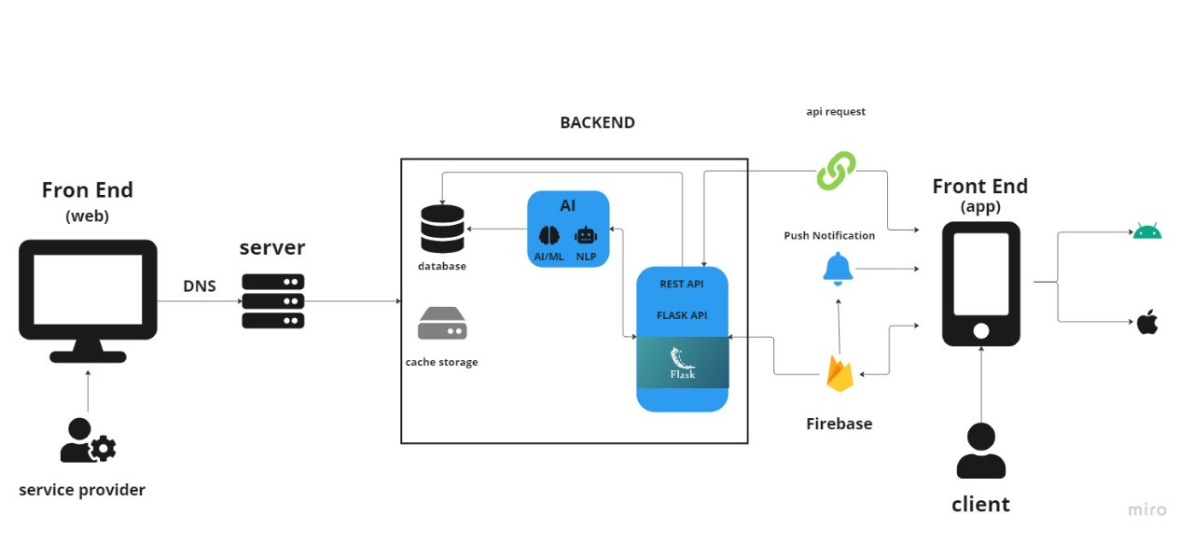

GLOBAL SYSTEM ARCHITECTURE

Slide 16




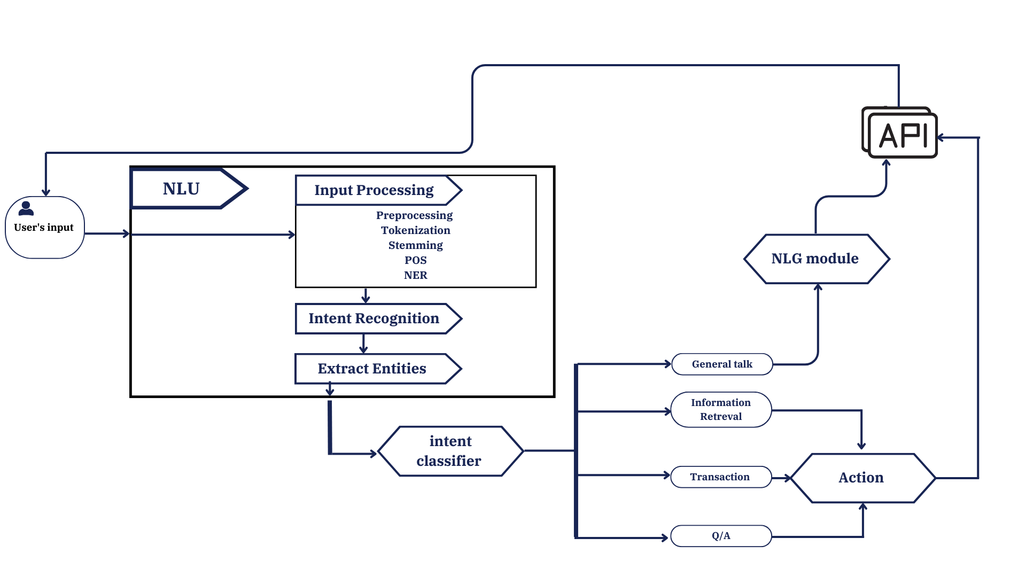
CHATBOT MODULE
DESIGN

Slide 17
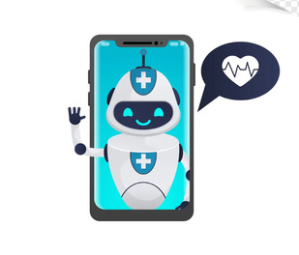
NATURAL LANGUAGE UNDERSTANDING
The goal of this unit is to understand the user's intent:
for our application, we had the following intents that the chatbot was trained to understand:
greet
goodbye
affirm
deny
appointments
medicines
book
dermatology-Department
bone-Department
eye-Department
internal-Department

Slide 18
IMPLEMENTATION
PIPELINE:
Whitespace Tokenizer
RegexFeaturizer
LexicalSyntacticFeaturizer
CountVectorsFeaturizer
DIETClassifier
EntitySynonymMapper
FallbackClassifier
RulePolicy
Pipeline components:
Min_ngram and Max_ngram
Epochs:
Max_history

Slide 19

TRAINING
We created a dataset of possible user input for each intent and used it to train the classifier.
Depending on the identified intent the chatbot can:
give a fixed response
give a generated respond

Slide 20
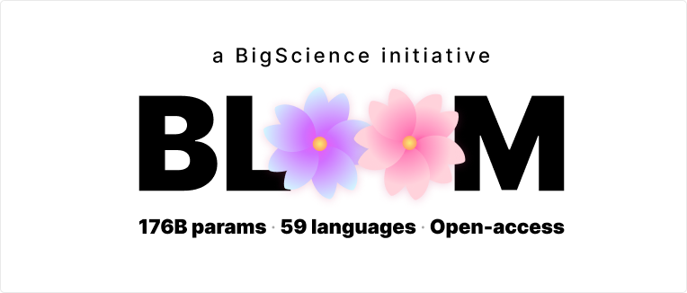
GENERATIVE RESPONSE
For the generative response, we used a pre-trained LLM called

Slide 21
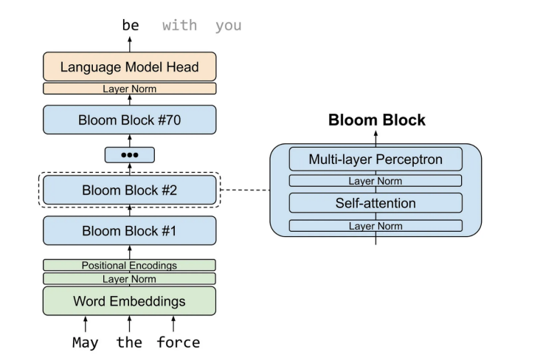
BLOOM is a transformer-based language model

Slide 22
GENERATIVE RESPONSE
For LLM like BLOOM, there are 2 main techniques for training and adapting the model:
Fine-tuning
The process of customizing a pre-existing and expansive language model (LLM) to suit a particular task or domain.
Prompt engineering
Focuses on the development and optimization of prompts to effectively utilize language models (LMs)

Slide 23
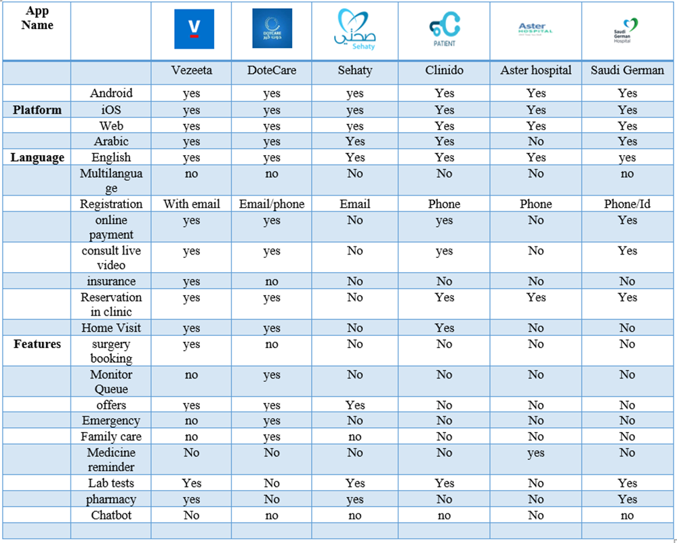
SIMILAR APPLICATION

Slide 24

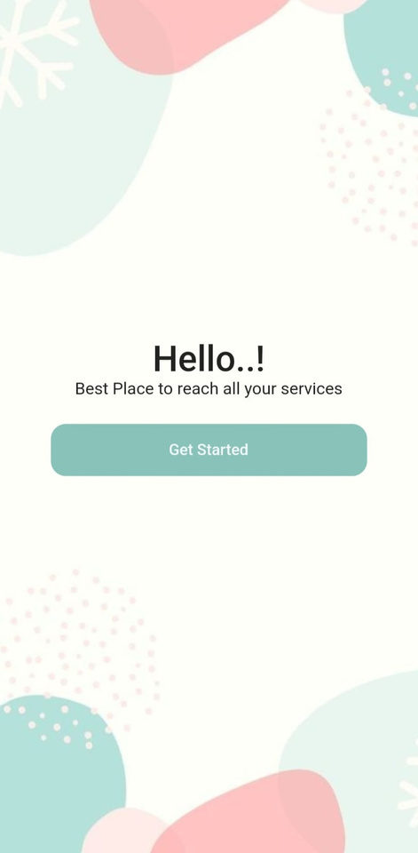
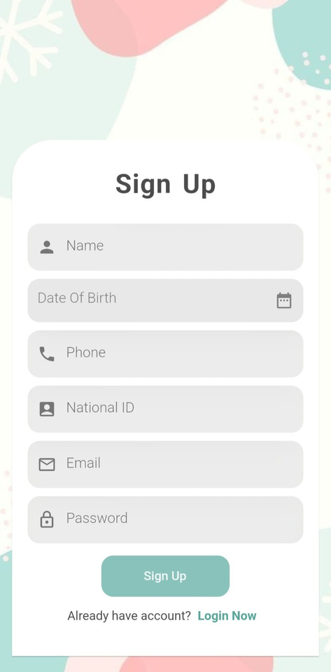
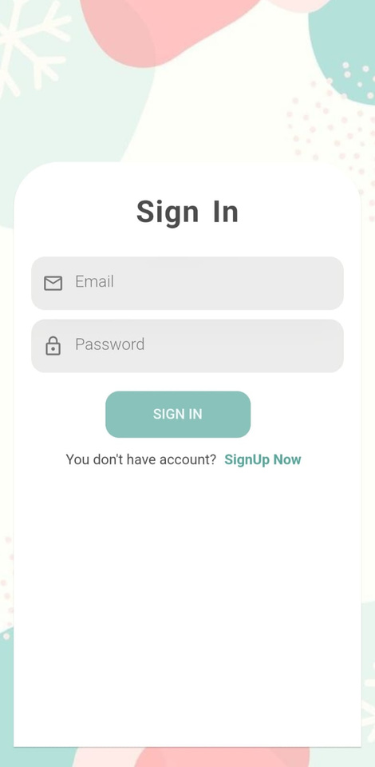
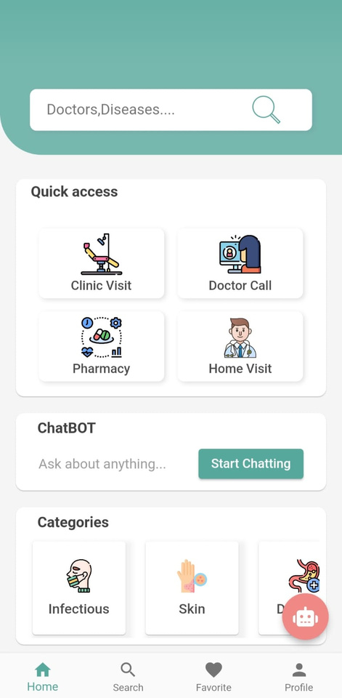
MOBILE APPLICATION
DESIGN

Slide 25
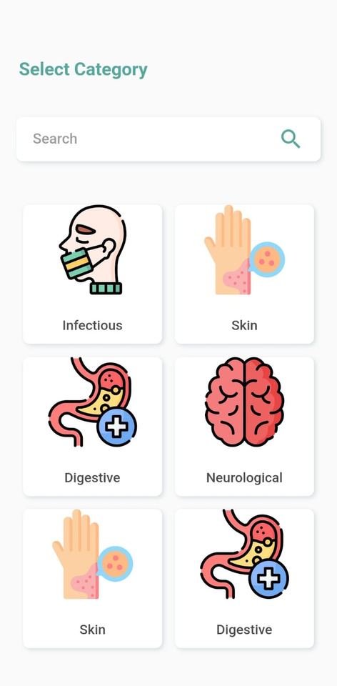
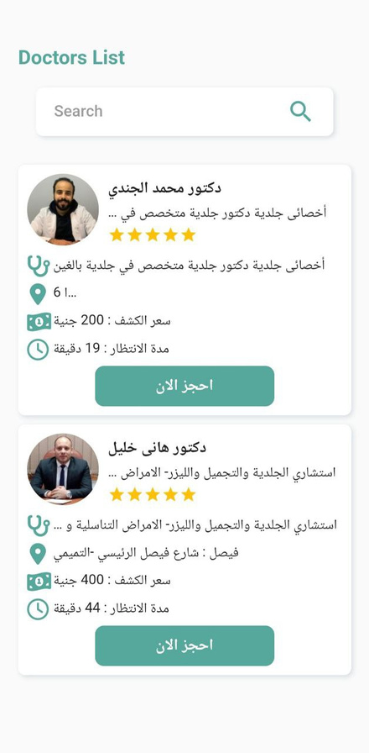
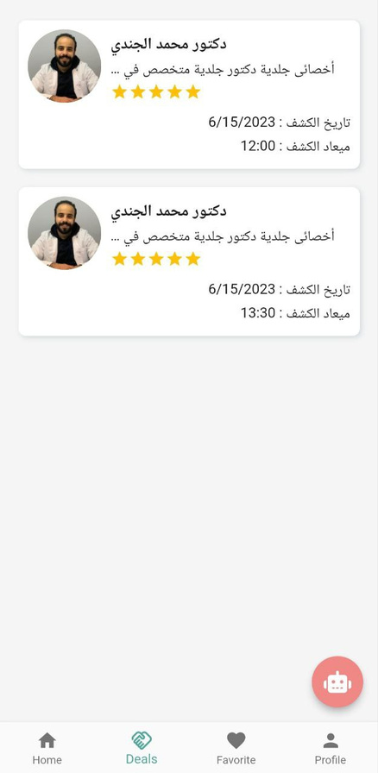
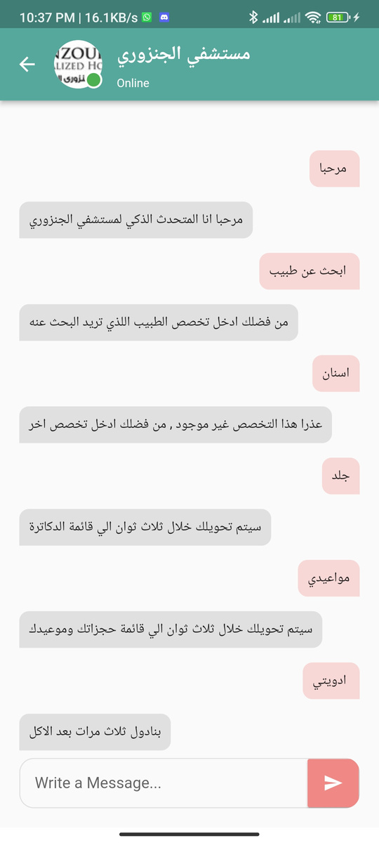
MOBILE APPLICATION
DESIGN

Slide 26
MOBILE APPLICATION
FEATURES
CROSS-PLATFORM
VIEW AND SEARCH DOCTORS
VIEW DOCTORS PROFILE
BOOK APPOINTMENT
VIEW APPOINTMENT
Chat with bot

Slide 27
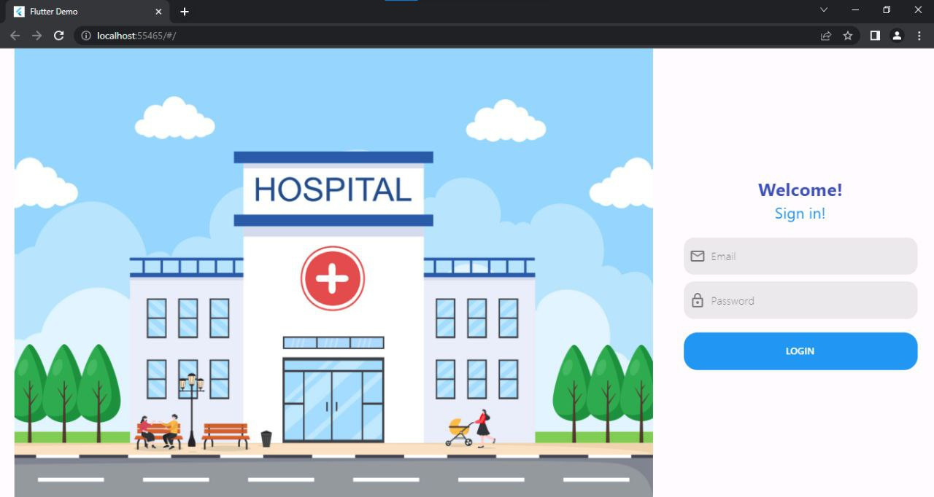
WEB APPLICATION
DESIGN

Slide 28
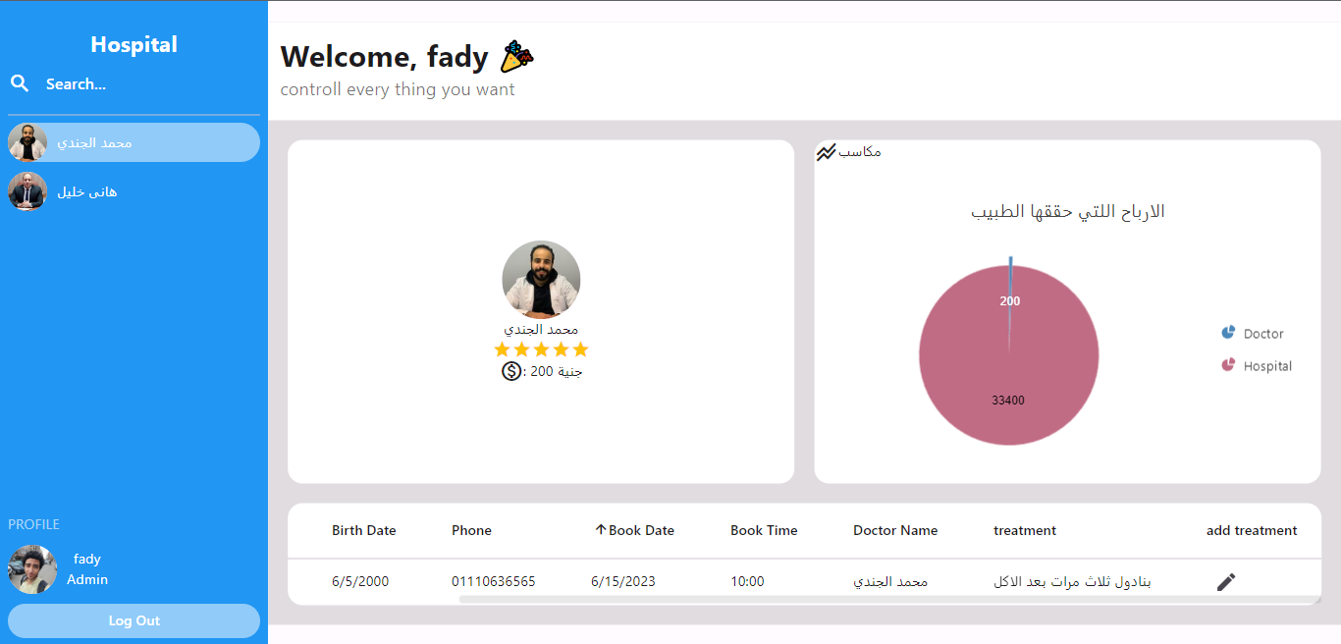
WEB APPLICATION
DESIGN

Slide 29
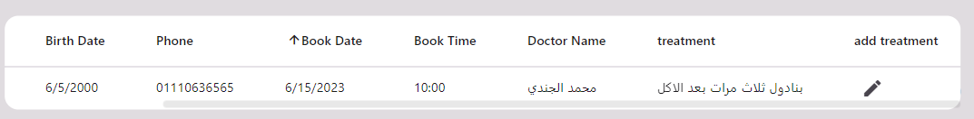
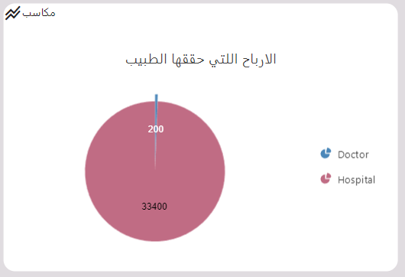
WEB APPLICATION
DESIGN

Slide 30
WEB APPLICATION
FEATURES
REGISTED A DOMAIN NAME
HOSTED ON SERVER
FIREBASE DATABASE
DOCTORS CAN VIEW PATIENT LIST
CAN SEND MEDICATION TO PATIENT
RECEIVE NOTIFICATION FROM DOCTOR

Slide 31
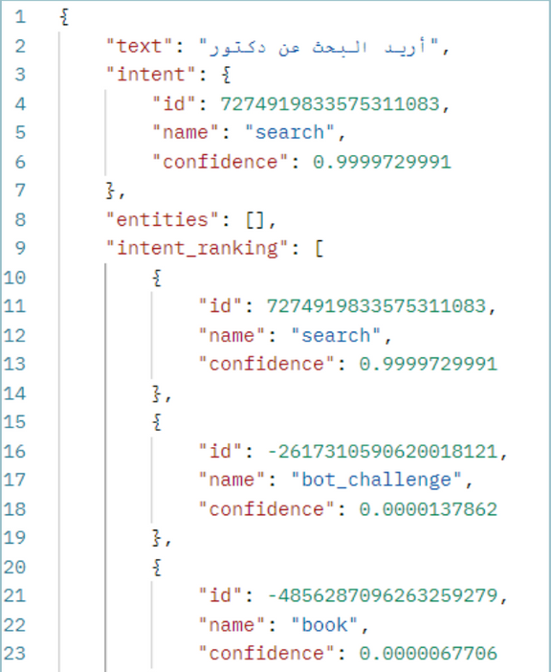
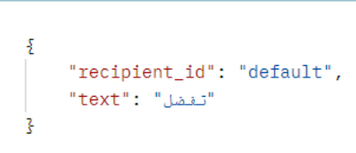
INTERFACE
INTERFACING BETWEEN THE MOBILE APPLICATION AND THE CHATBOT THROUGH AN API
RESPONSE API
INTENT CLASSIFICATION API

Slide 32
SYSTEM TESTING

Slide 33

TESTING
MOBILE APP TESTING
CHATBOT TESTING
WE DID A FUNCTIONALITY TEST ON THE MOBILE APPLICATION TO INSURE ALL FUNCTIONS ARE WORKING
WE DID A HUMAN EVALUATION TEST TO INSURE THE CHATBOT RESPONDS APPROPRIATELY.

Slide 34
FUTURE WORK

Slide 35
FUTURE WORK
ADDING MORE FEATURES
ADD MORE DOMAINS
VOICE RECOGNITION
VOICE REPLY
SENTIMENT ANALYSIS
AUGMENTED VIRTUAL ASSISTANT
IMPROVE THE PERFORMANCE OF THE CHATBOT

Slide 36

THANK YOU

